Slide 1
Trial Class Application For Maths
Student Teacher Communication and Learning Platform
Abhijeet Upadhyay
2021mt93579@wilp.bits-pilani.ac.in

Slide 2
System and Goal
- System allows student ( or parent on behalf of student ) to book a trail class for Maths education and then have a video class on scheduled time.
- Goal of the system is to have an highly efficient video class platform with easy interface to book class and then have a trail video class at scheduled time.

Slide 3
Key Requirements
Functional Requirements:
- Users ( Student and Teacher ) should be able to login in to system ( web + mobile )
- Student should be able to book a class through a scheduler
- Student should be able to join class at designated class time
- Teacher should be able to join class at designated time
- Teacher should be able to present an applet related to course for discussion
- Teacher should be able to present an a white board to discuss and draw things
- Student should be able to see Applet and whiteboard
- Applet and whiteboard communication must be two way
- Teacher should be able to send rewards to student in terms of Hats-Off animations and emojis
- Teacher should be able to end class
Non Functional Requirements:
- Very high performant system for live video streaming. ( concurrent 500 streams at a time )
- Very high available system for video classes ( concurrent 500 streams at a time )
- High security to prevent loss of proprietary educational content.
- Highly available system as classes happens daily throughout year

Slide 4
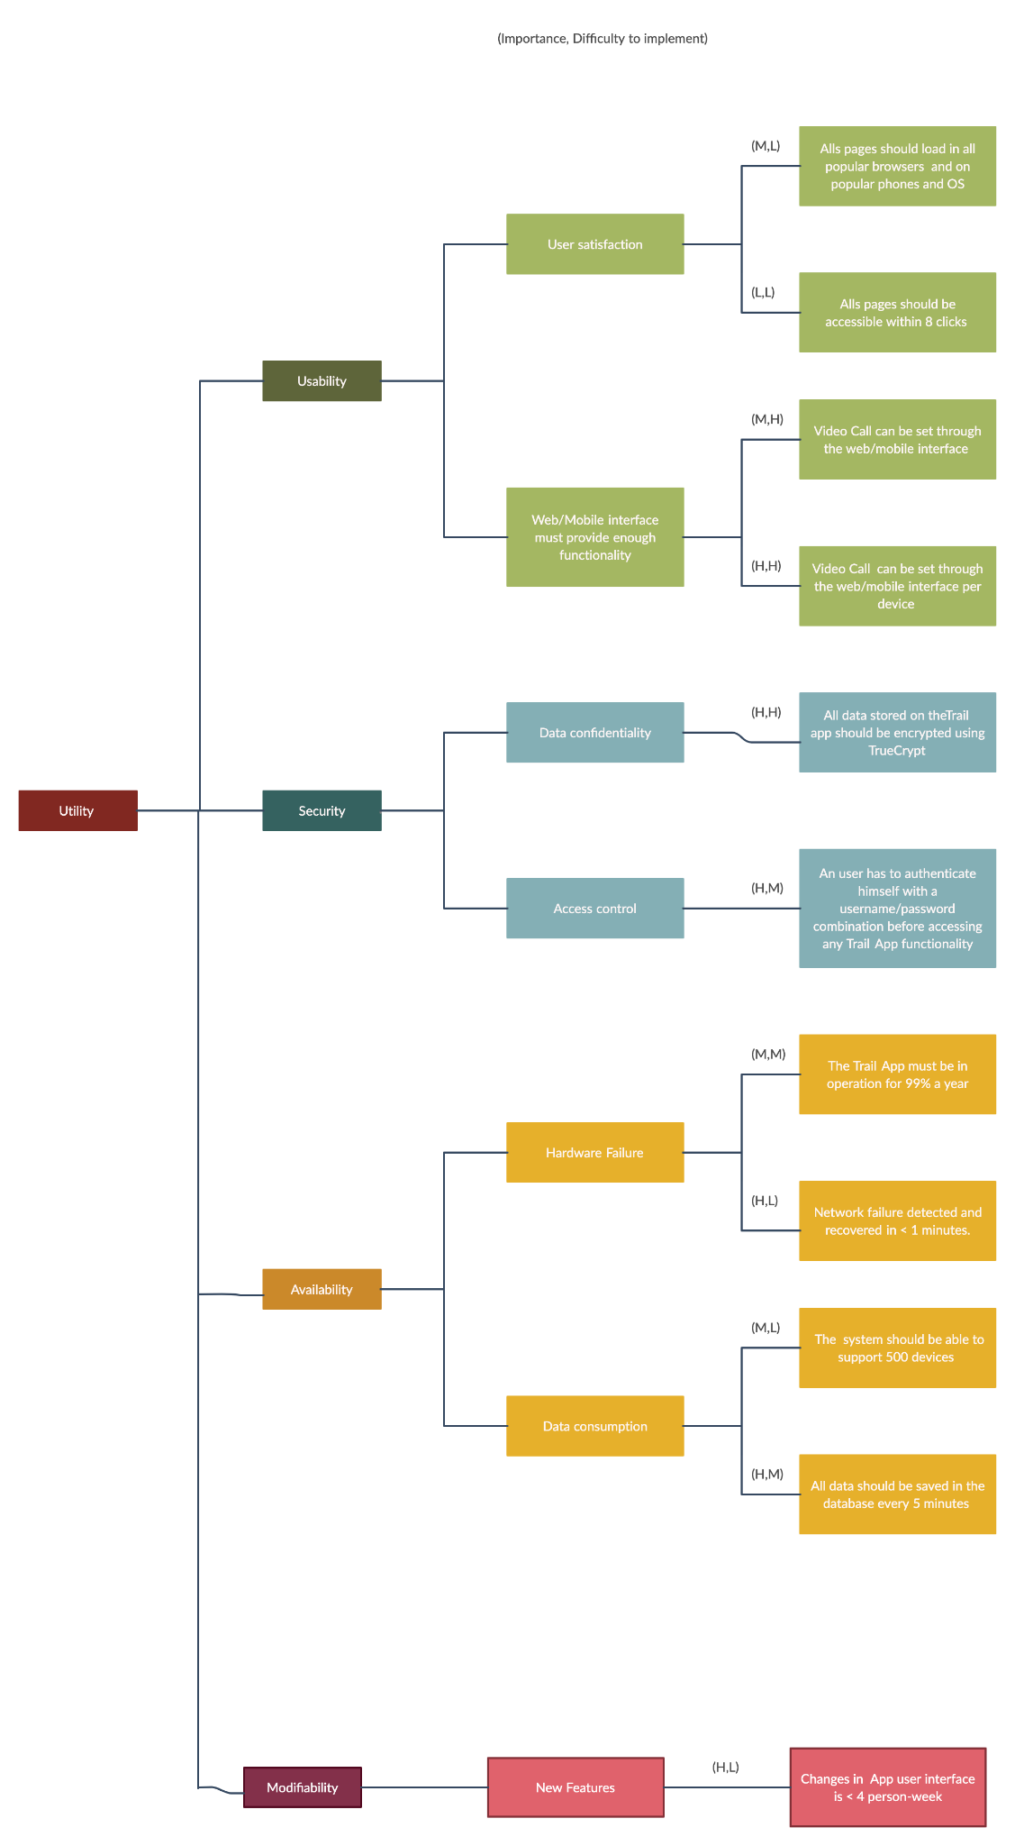
Utility Tree Diagram

Slide 5
Tactics used to achieve ASRs
Availability
Server fault detection system at place using heartbeat mechanism
Redundancy maintained through AWS Cloud horizontal scaling system used for 99% available system
Rollback and System Monitor at place for fault recovery and fault detection
Security:
Service Denial and Message detection at place
Attack resistance is at palace through data encryption and actor authorisation with data access limit
System reboot and lock and availability check after restore is at place
Ongoing and automated inspection and monitoring of web assets and JavaScript to be aware of any unauthorized script activity.
Usability:
Made the system browser agnostic
Separate user interface using Clean Architecture
Made the system OS agnostic
Mobile Screen Responsiveness to make web portals device agnostic
Performance:
Resource demand and management handled with CDN at place for caching and faster retrieval to achieve maximum performance
Extensive multithreading and background tasks are used for client side performance ( web/mobile apps )
Performance dashboard indicating multiple metrics set for real time monitor of performance
At a time 500 classes can happen parallelly with server using data streaming technologies like kafka spark and hadoop
Modifiability:
Microservices and MicroFrontend Architectures to make system highly modifiable.
Used Clean Architecture Patterns like onion architecture to create web app and mobile app which can be modified easily
Hyper separation of concern, SOLID principles and composition over inheritance used to achieve easily modifiable modules

Slide 6
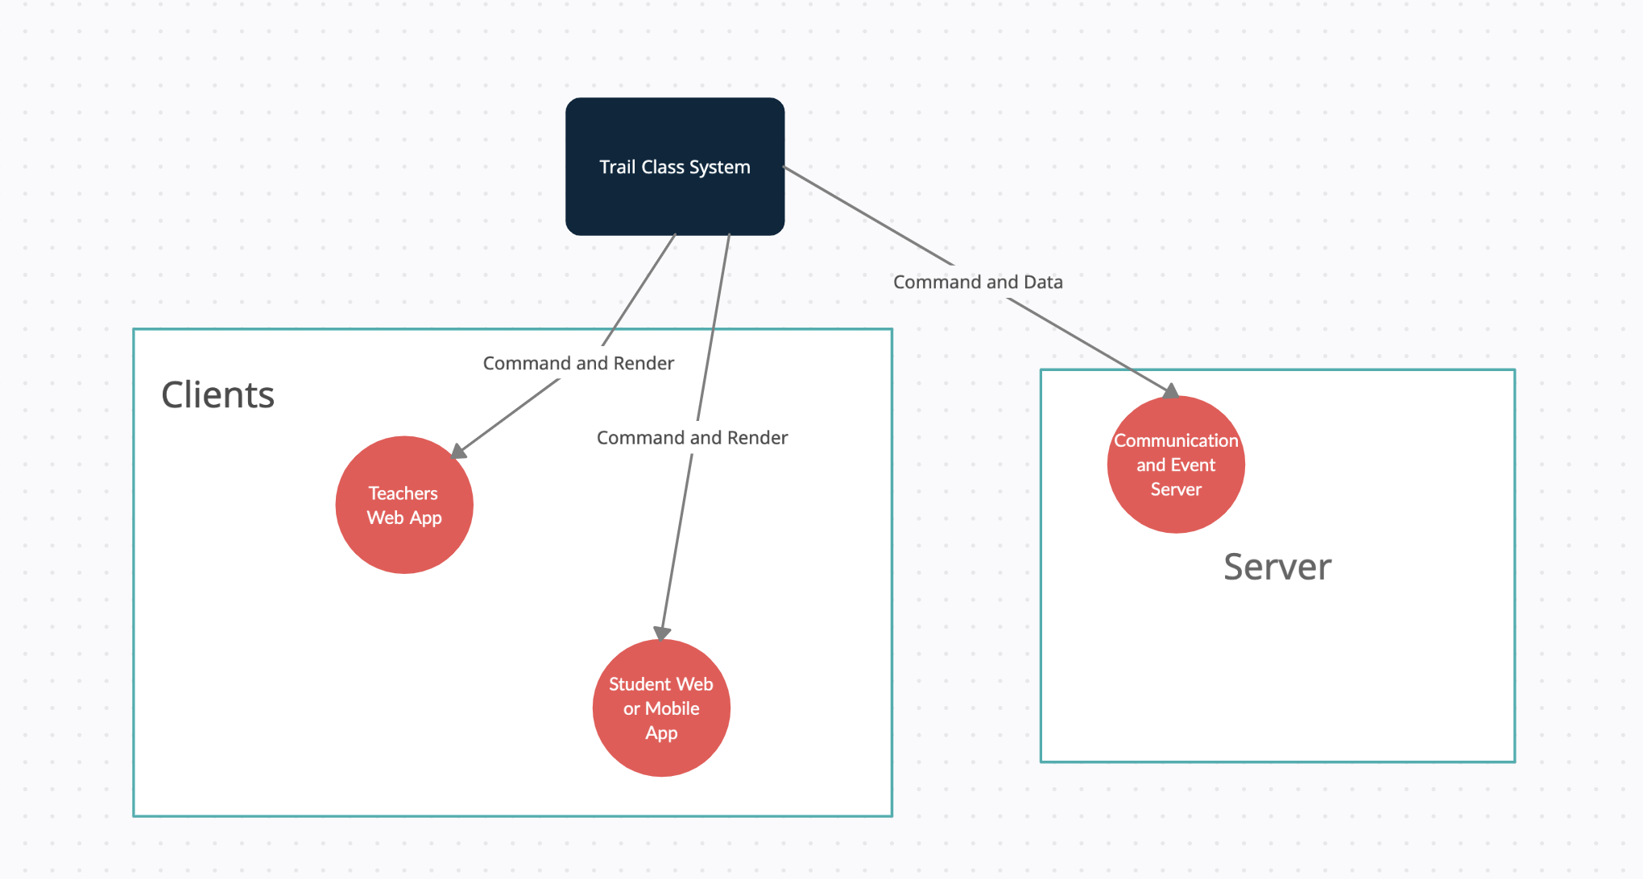
Context Diagram

Slide 7
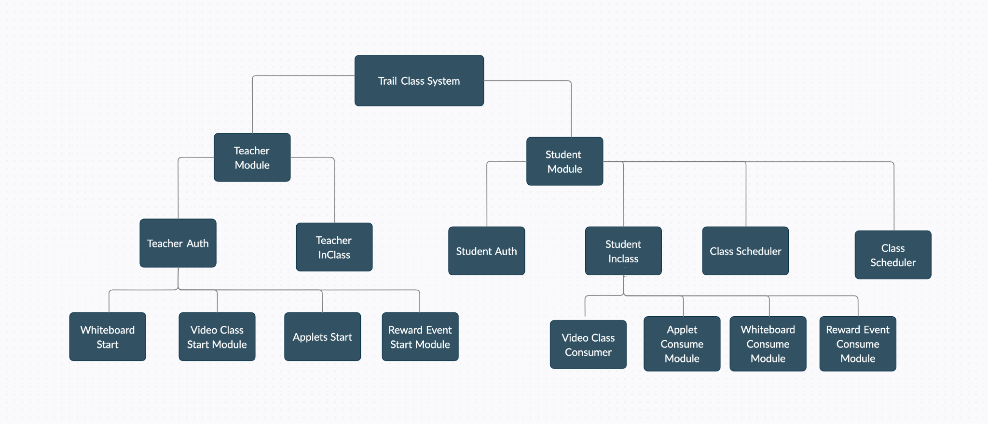
Module Decomposition

Slide 8
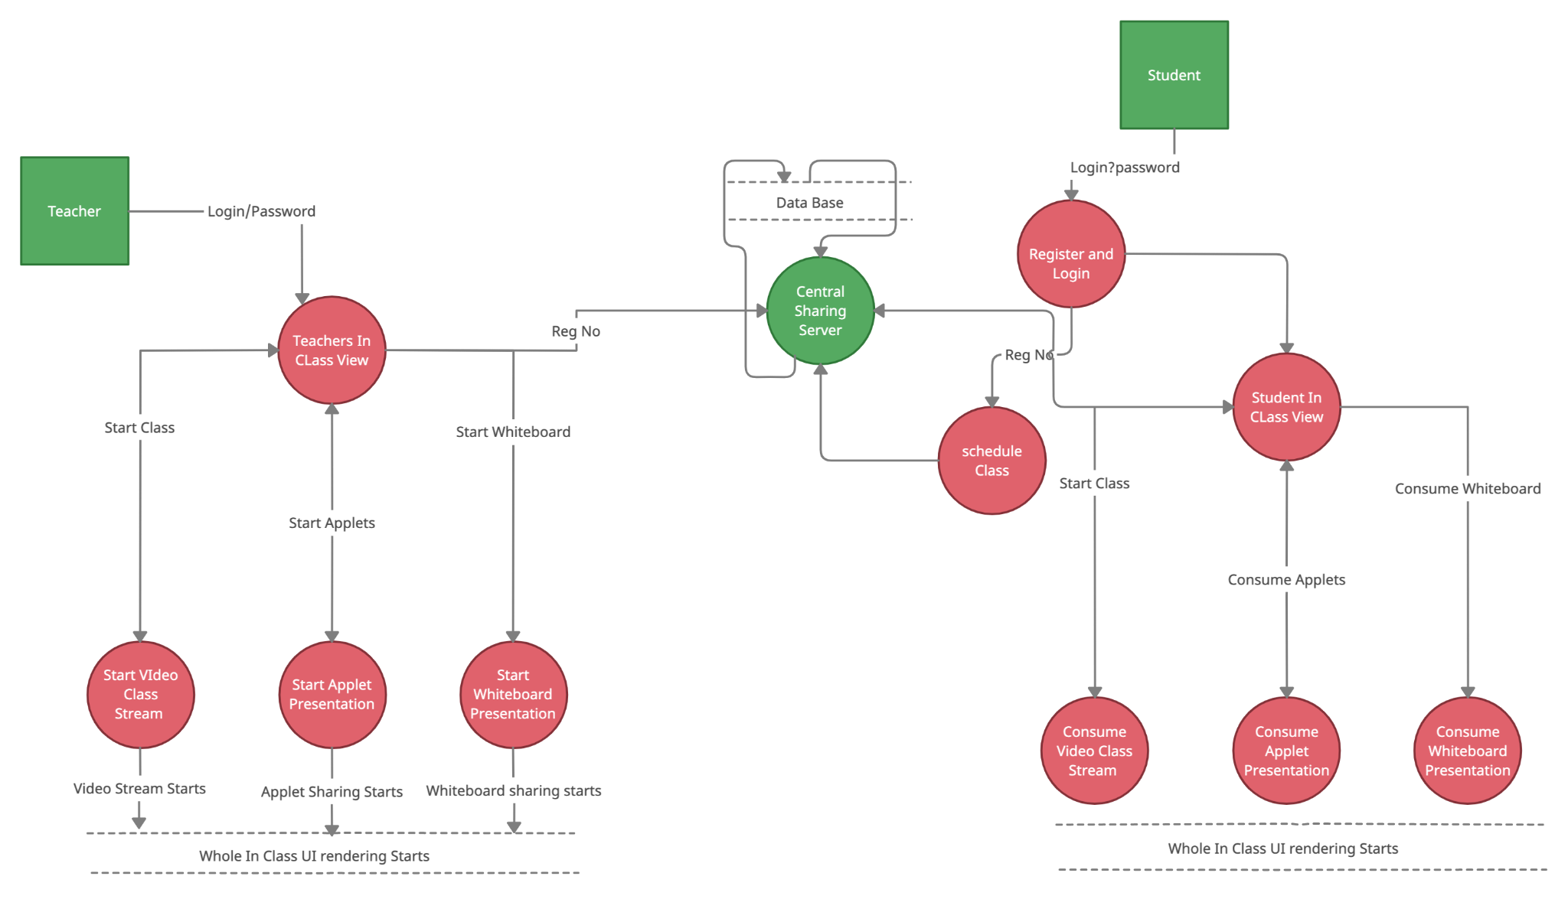
Component and Connection Diagram

Slide 9
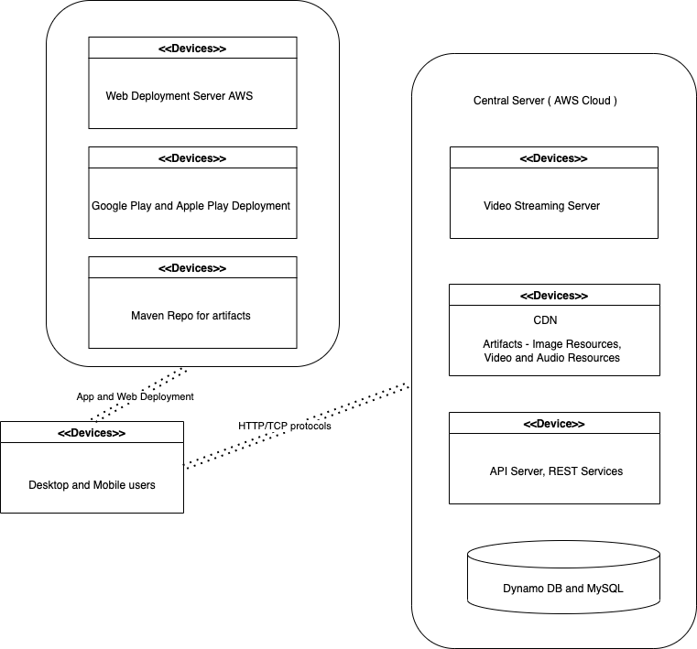
Deployment Diagram

Slide 10
How System Works
System is working as Client Server Architecture
There are two type of Clients which communicate with a central server ( Student and Teacher )
All sort of student and teacher communication happens through central server
Video/Audio Stream happened with a socket implemented on server
Technologies like spark and kafka at place to handle streams
Both clients have implementation of maths applets and whiteboard which can be shared through a central server.
Communication between Client and Server happens with REST services and Socket connection
For the reward events server sends real time events for client to capture
Web app is created with web technologies like React Js and Mobile Apps are created with React Native
Server follows the Microservices Architecture to provide REST APIs and Socket Connections

Slide 11
Key Learnings
Learnt to handle following challenges in architectural planning and design phase.
What is the time available for the architectural analysis/evaluation? It is challenging enough to come up with one solution, let alone a few!
What is the product pipeline for the next 1–3 years? And what other projects are lined up? Can we see any synergies?
What is system current technical debt that we could potentially address?
And turning this around: How much new technical debt will incur if you pursue a tactical solution?
Which quality attributes tend to be the most important for systems in my organisation and how will they be compromised by the proposed solution?
Apart from the architecture team who else is a stakeholder that will affect the decision? The Business? My boss? The Technical Design Authority? What are the key objectives of each stakeholder? How will I mitigate conflicting needs
Learnt to handle following technical, high level and low level design aspects of architecture planning
Such live video stream system require must plan for ASRs and NFRs at architectural planning level.
The SOLID principles just do not only apply on software development but also when architecting a system
Client System is live for an hour at a time so error handlings (Network, Hardware issues) must be at its best and well designed
User Interface is as important as functionality of the system as different type of users ( Teacher/Student ) using a complex UI
System availability and performance is most important concern and must be handled properly as system needs to be available throughout the year
As system is quite big module decomposition ( Microservices and Microfrontends ) should be planned seriously
Component connections can not be easily modifiable so must be planned before hand in architecture

